Slide 1
Science
Animals Including Humans
Science | Animals Including Humans | Animal Diets | Lesson 3

Slide 3
Meet Quizby!
I will appear like this, click me to reveal a key question.
Can you spot me in the Lesson Presentation?
Hi, I’m Quizby!
The questions that appear will help you to think about the key learning throughout the lesson.

Slide 4
Aim
To identify, name and sort animals that are herbivores, carnivores and omnivores.
Success Criteria
I can explain what herbivores, omnivores and carnivores eat.
I can identify what different animals eat.
I can sort animals into the diet groups they belong to.

Slide 5
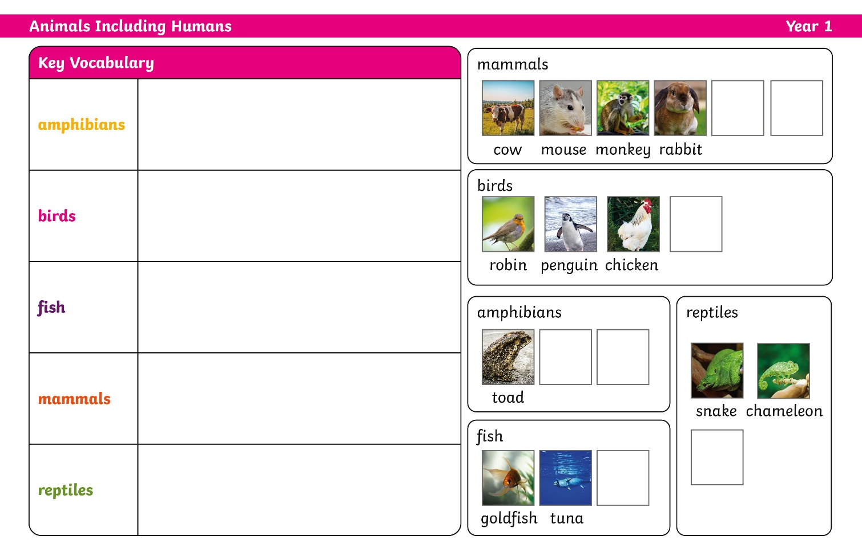
Remember It
Our Knowledge Organiser has some parts missing.
Can you use what you know to help me to complete it?

Slide 6
Remember It
Match the description the right group. Talk to you partner about which group you think each is.
have a beak, two legs, feathers and wings.
Amphibians
Birds
live in water. They have scaly skin, fins to help them swim and breathe through gills.
Mammals
Fish
are animals that breathe air, grow hair, or fur and feed on mother’s milk as a baby.
Birds
Mammals
Fish
breathe air. They have scales on their skin.
Reptiles
Reptiles
live in the water as babies and on land as they grow older. They have smooth, slimy skin.
Amphibians

Slide 7
Remember It
Well done! Can you name the animals and put the missing pictures in the right groups?
dog
human
flamingo
newt
frog
shark
tortoise

Slide 8
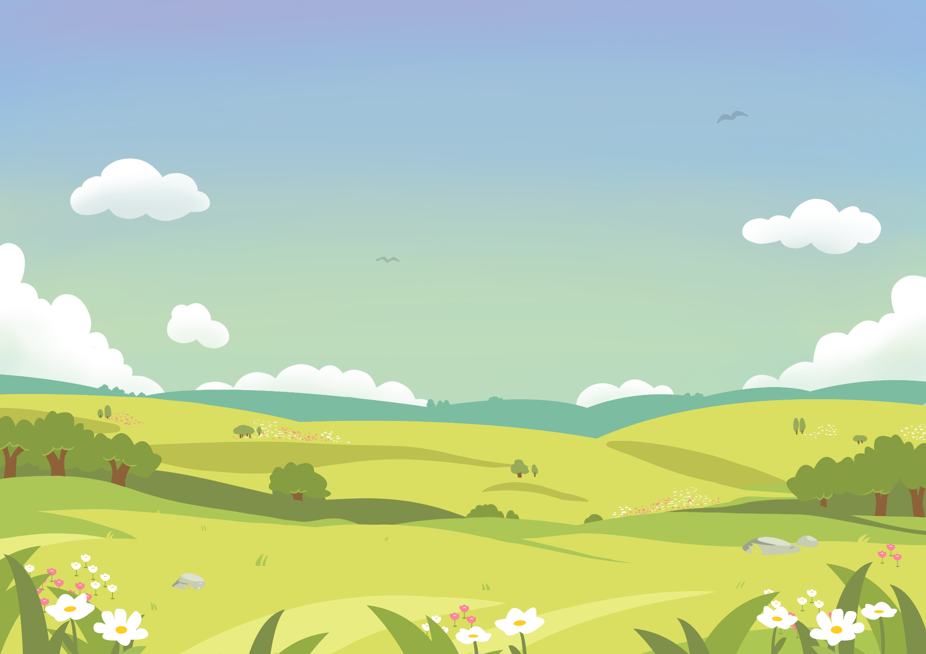
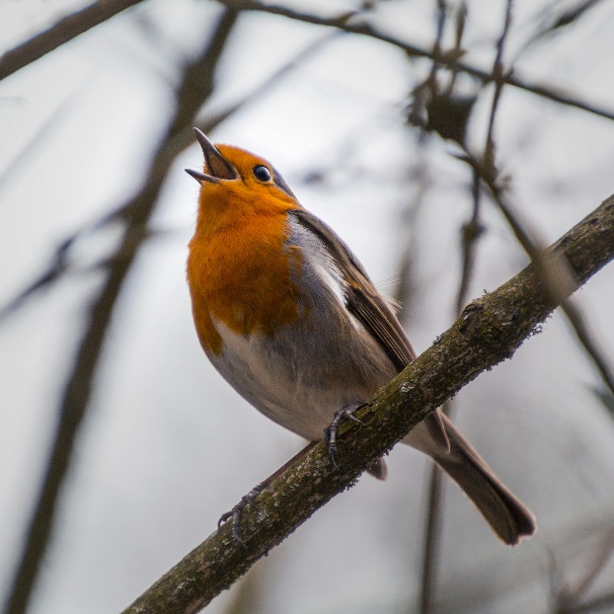
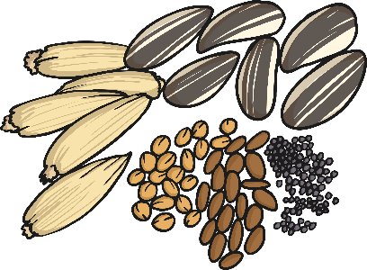
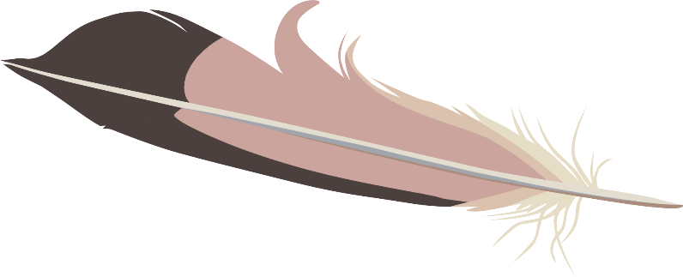
Diets
All living things need to eat. We call what animals eat their diet.
What do you think this animal eats? Talk to your partner.
robin
Robins eat insects and worms. They also eat fruit, seeds, peanuts and even little bits of grated cheese!

Slide 9
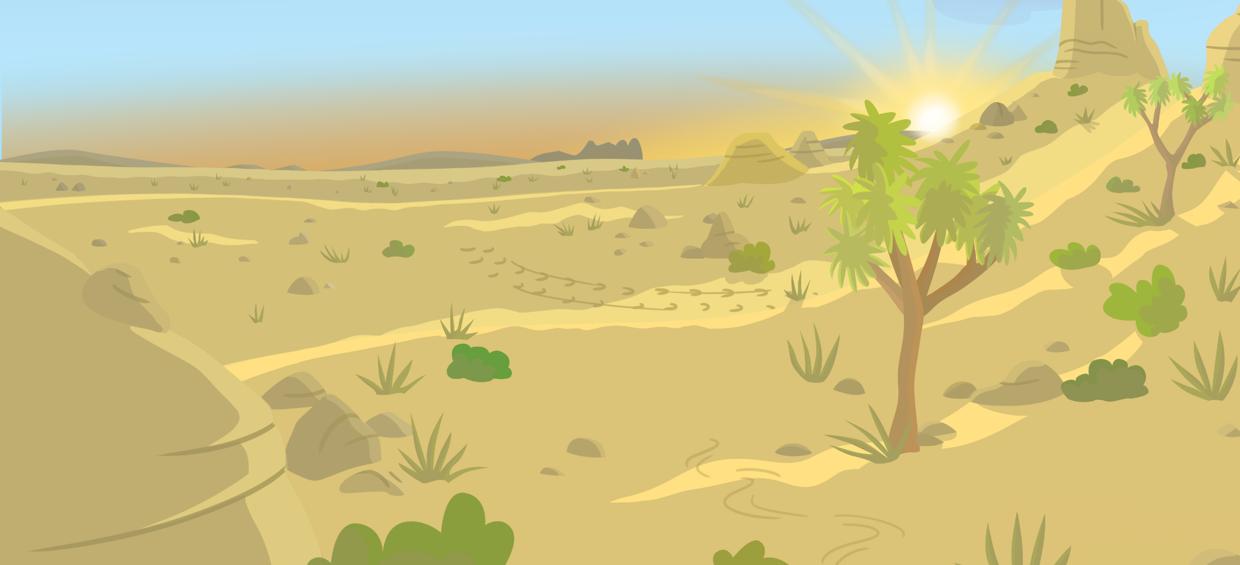
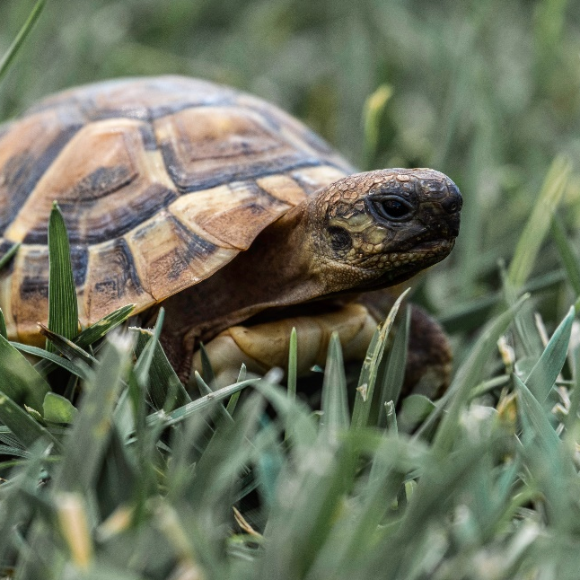
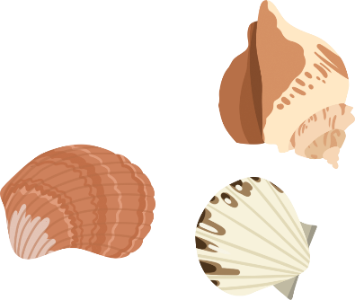
Diets
All living things need to eat. We call what animals eat their diet.
What do you think this animal eats? Talk to your partner.
tortoise
Tortoises and turtles both eat plants.

Slide 10
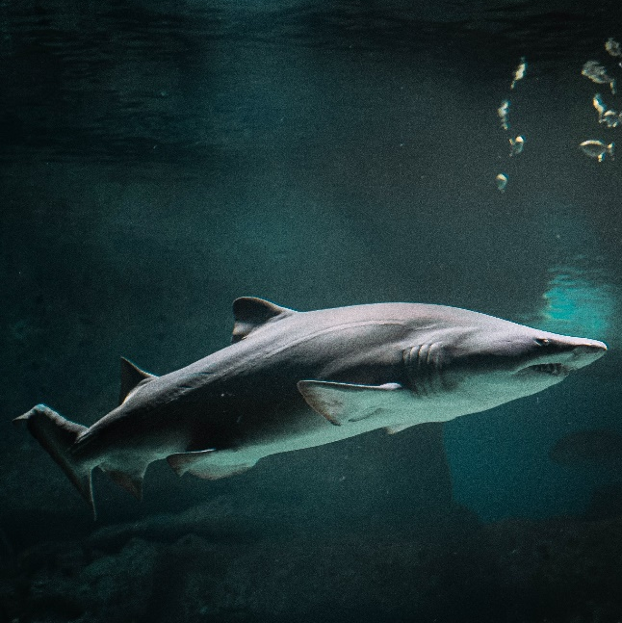
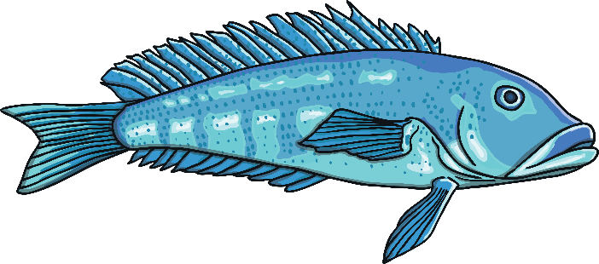
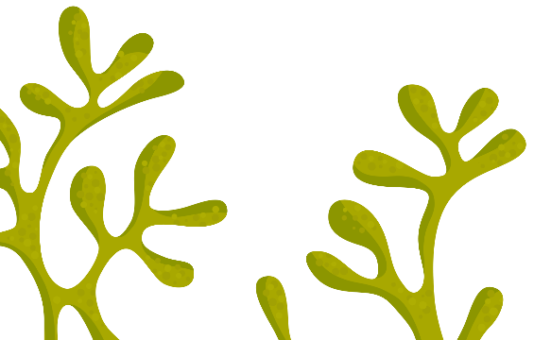
Diets
All living things need to eat. We call what animals eat their diet.
What do you think this animal eats? Talk to your partner.
shark
Sharks eat fish and other animals that live in the sea.

Slide 11
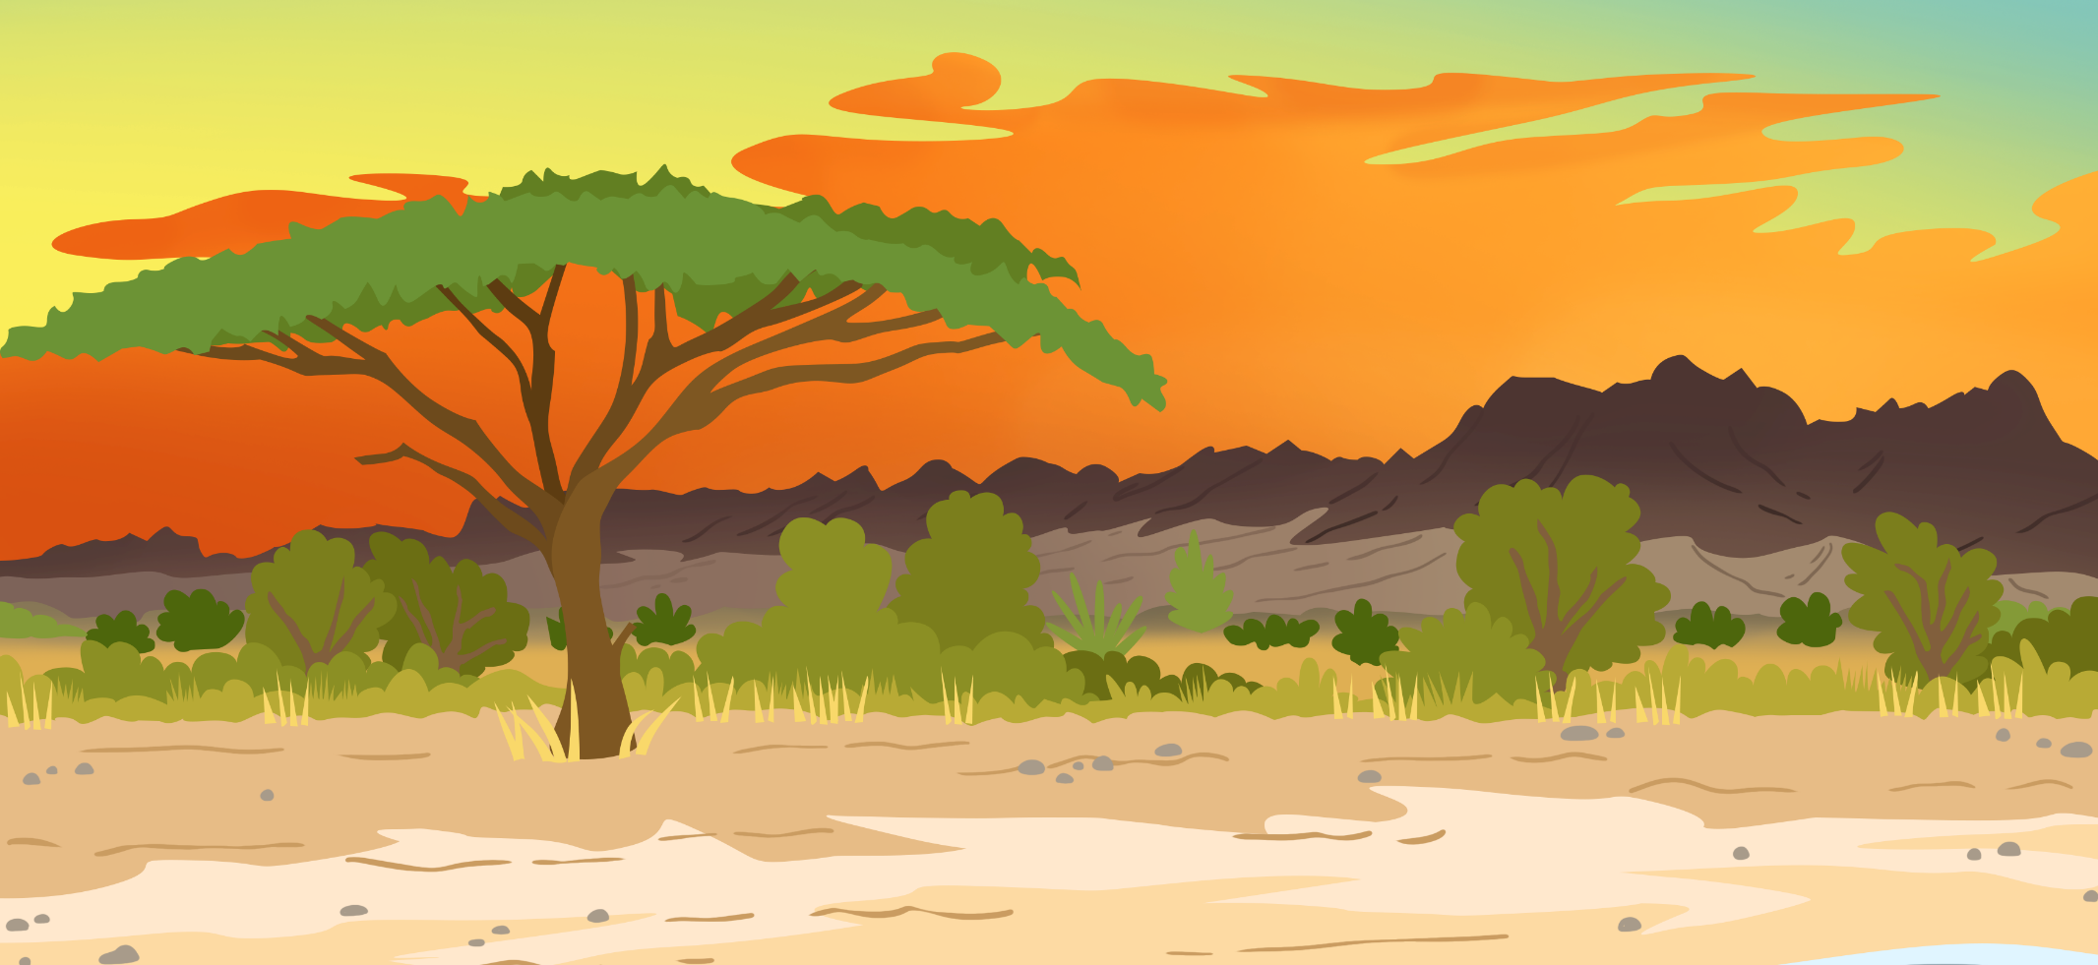
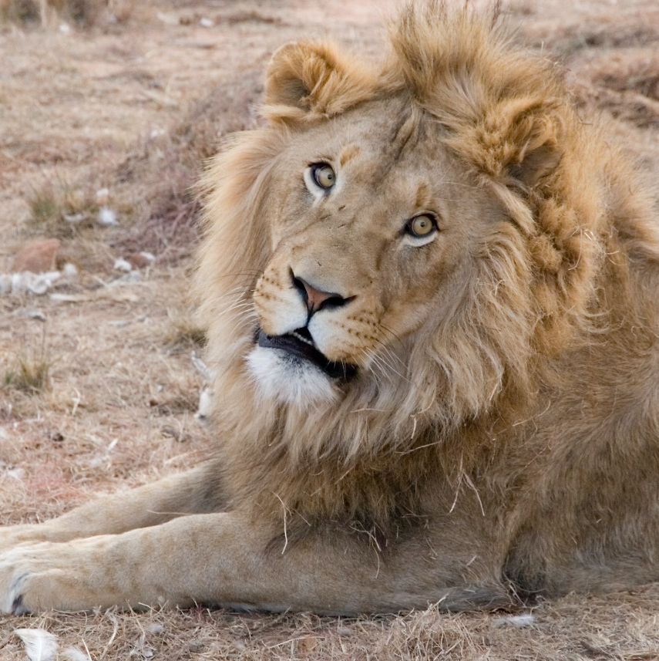
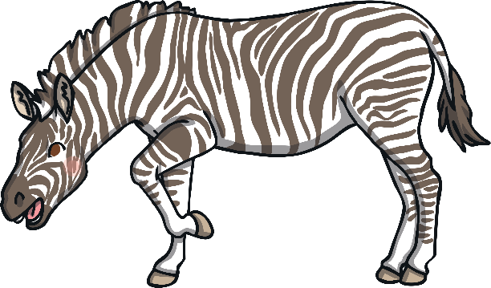
Diets
All living things need to eat. We call what animals eat their diet.
What do you think this animal eats? Talk to your partner.
lion
Lions eat other animals, such as giraffes and zebras.

Slide 12
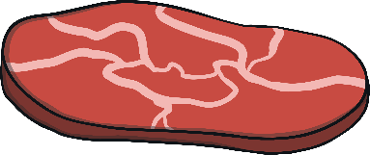
Diets
Animals can be sorted into three groups of diets:
carnivore
herbivore
omnivore
Carnivores mostly eat meat. This is the flesh from animals.
Herbivores eat plants. This includes the leaves, fruit and seeds.
Omnivores eat both plants and meat.

Slide 13
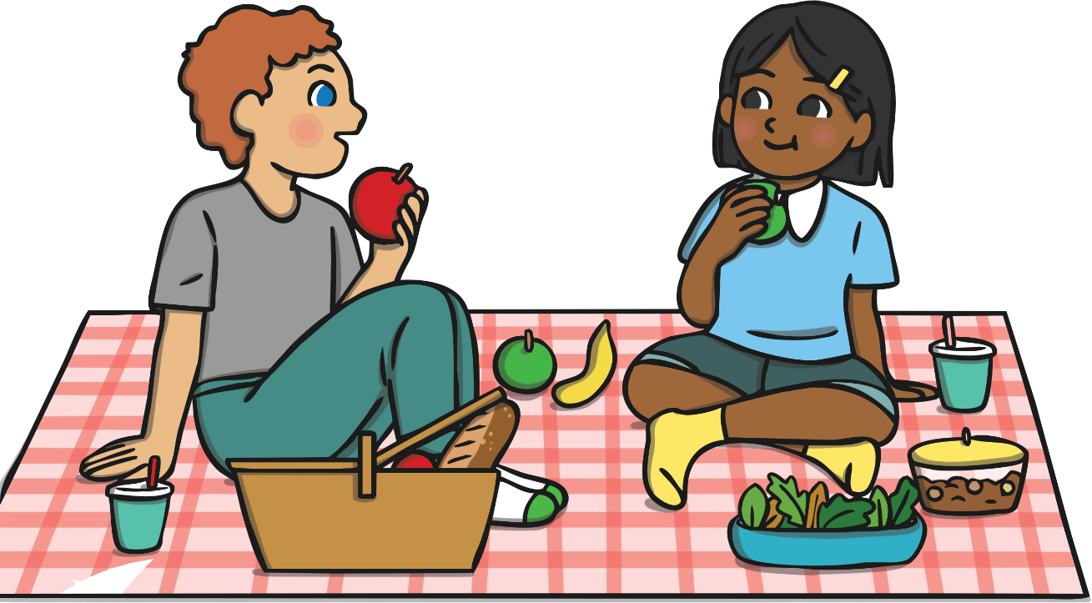
Diets
Tell your partner what kind of food you eat and which diet you think you have. Are you a carnivore, omnivore or herbivore?
Humans are naturally omnivores. Their bodies are made for eating meat and plants.
Some humans choose not to eat meat.

Slide 14
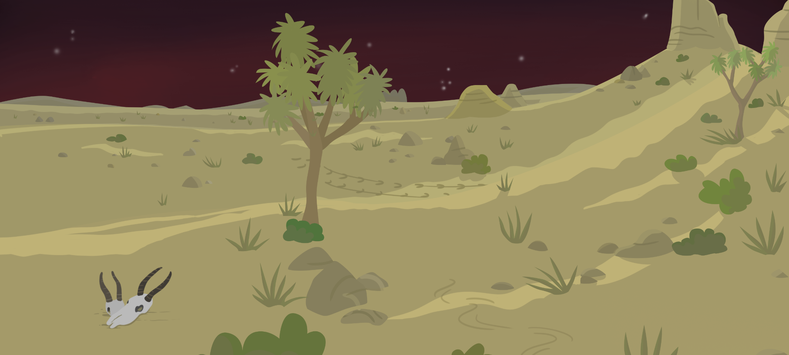
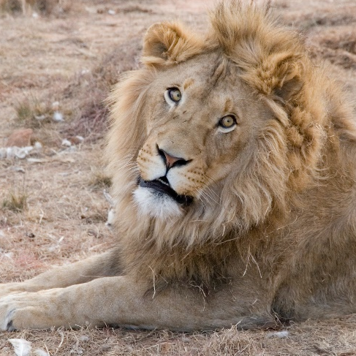
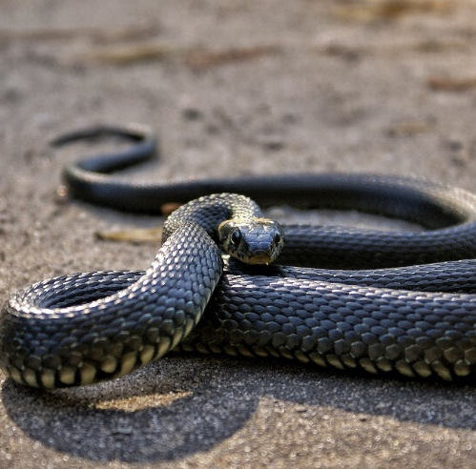
Herbivores, Carnivores and Omnivores
Carnivores
These animals are all carnivores. Which animal groups do they belong to?
lion
snake
shark
bat

Slide 15
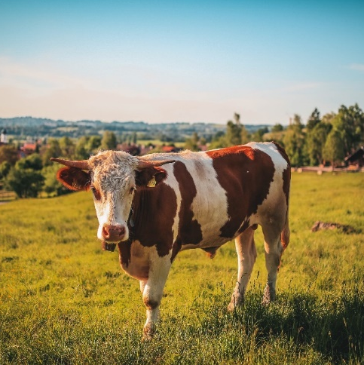
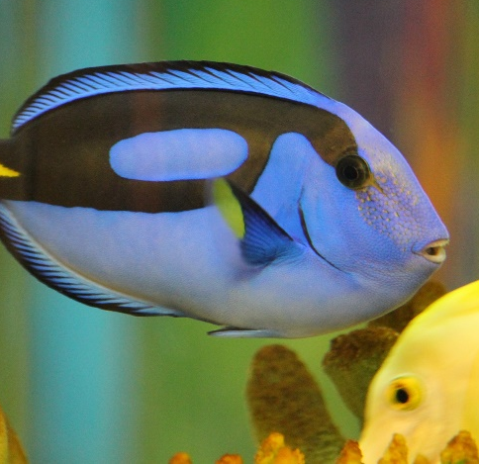
Herbivores, Carnivores and Omnivores
Herbivores
These animals are all herbivores. Which animal groups do they belong to?
horse
rabbit
tortoise
cow
blue tang

Slide 16
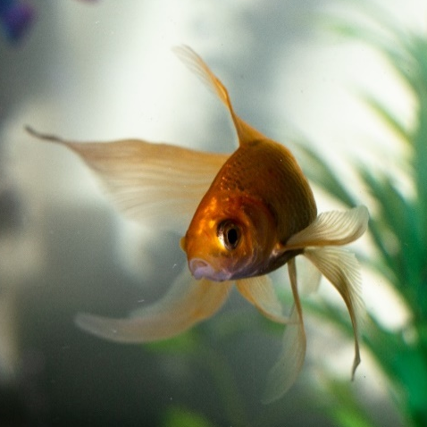
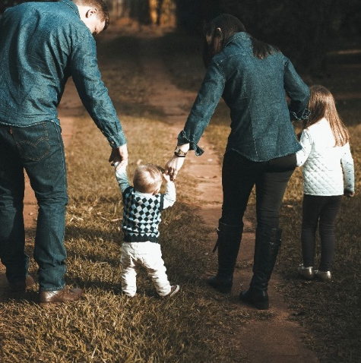
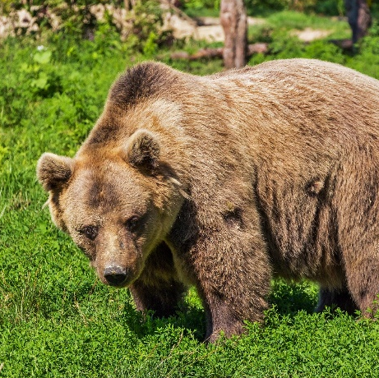
Herbivores, Carnivores and Omnivores
Omnivores
These animals are all omnivores. Which animal groups do they belong to?
fox
goldfish
human
robin
bear

Slide 17
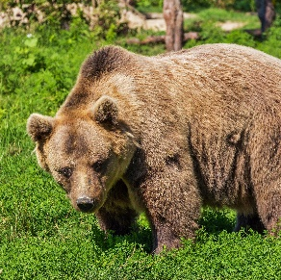
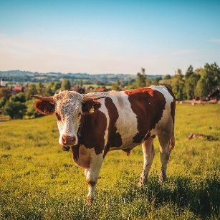
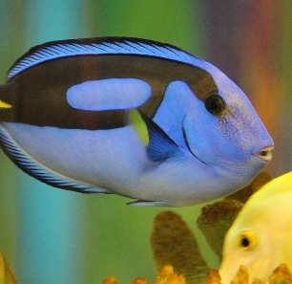
What Do They Eat?
Sort the animals into their diet groups.
carnivores herbivores omnivores

Slide 18
What Do They Eat?
Herbivores
Carnivores
Omnivores

Slide 19
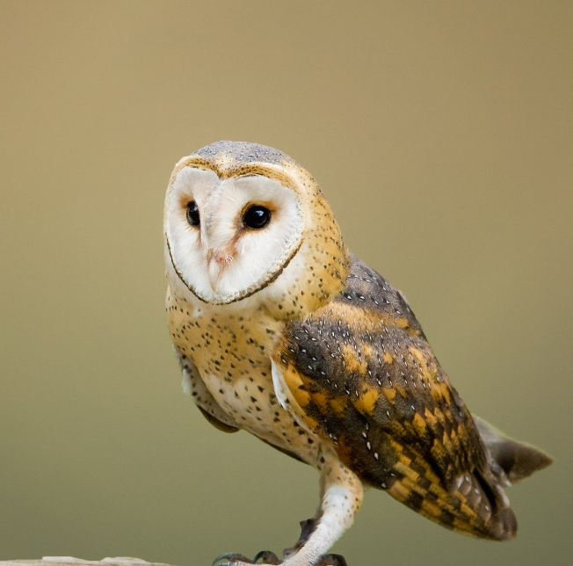
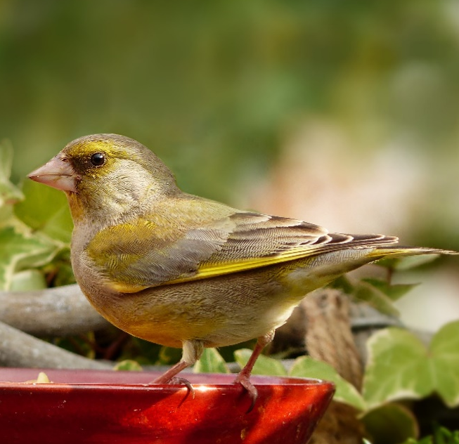
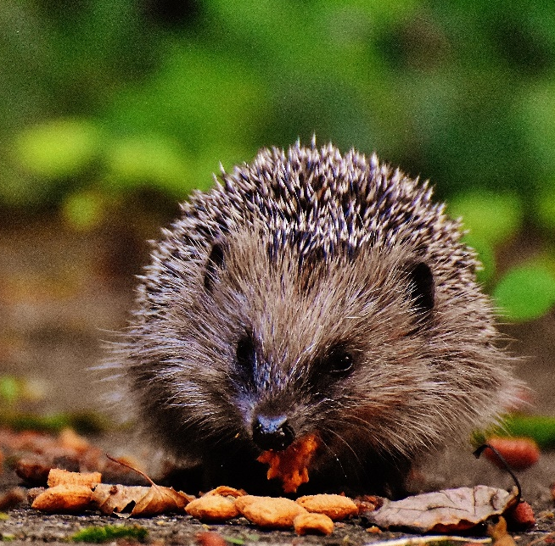
What Do They Eat?
barn owl
greenfinch
hedgehog
X
What do you think these animals eat?
Talk to your partner.
How can we find out?
We can use a secondary source, such as a non-fiction text.

Slide 24
What Do They Eat?
barn owl
greenfinch
hedgehog
Barn owls eat mice, shrews, voles and sometimes even frogs.
Greenfinches eat seeds.
Some mammals, such as mice and hedgehogs, eat seeds, plants and meat.
omnivore
carnivore
herbivore

Slide 25
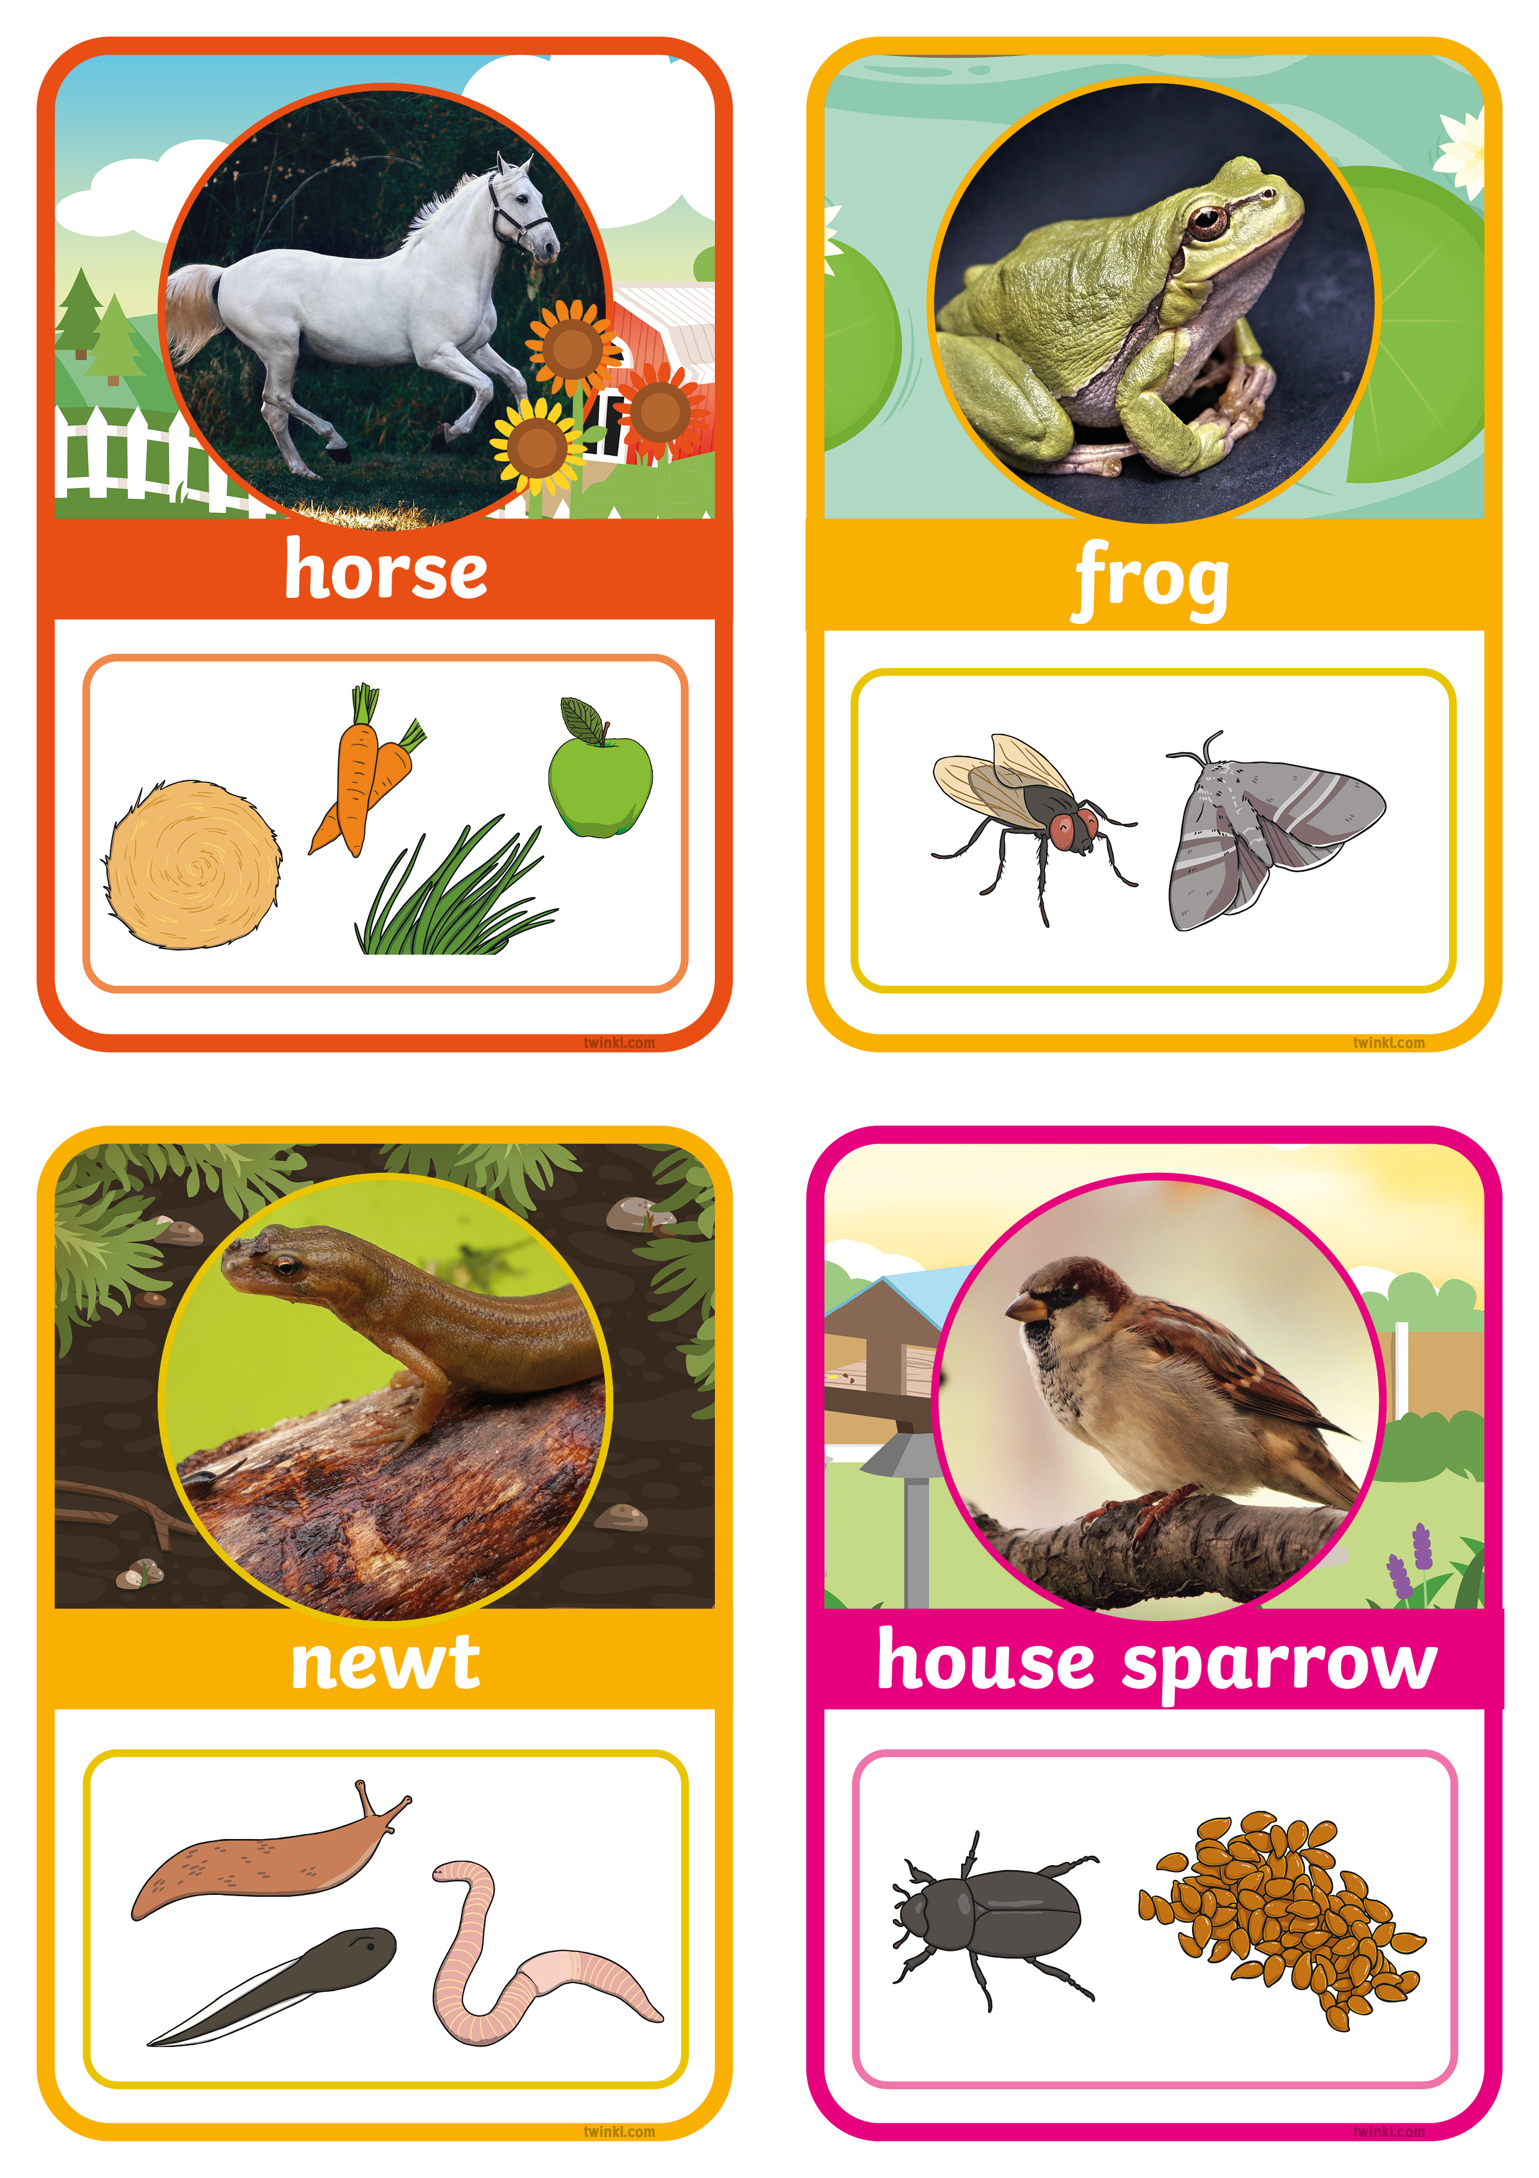
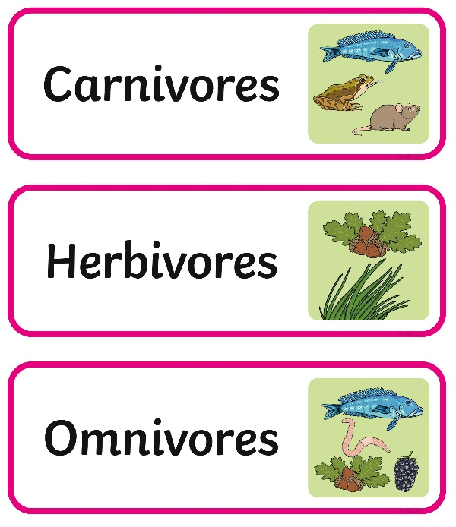
What Do They Eat?
Working with a partner, you are going to sort animals according to their diet.
You need to sort the animals into herbivores, carnivores or omnivores.
Challenge!
Can you find any similarities or differences between animals who eat the same diet?

Slide 26
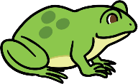
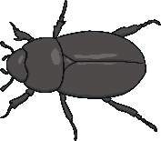
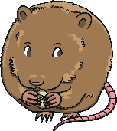
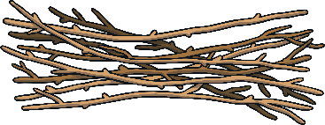
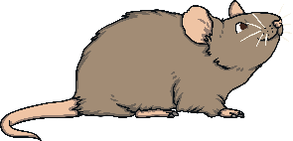
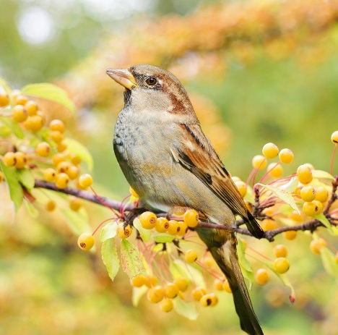
Dinner Is Served
Can you match the animals to the food they would eat?

Slide 27
Aim
To identify, name and sort animals that are herbivores, carnivores and omnivores.
Success Criteria
I can explain what herbivores, omnivores and carnivores eat.
I can identify what different animals eat.
I can sort animals into the diet groups they belong to.

