Slide 2
How Does a ‘Sore Loser’ Behave?
?
?
?
Gloating if they win
Only thinking about themselves winning
Only enjoying the game if they are winning
?
?
?
Being grumpy if they lose
Not helping others achieve or score
Being hurtful to others

Slide 3
How Does a ‘Sore Loser’ Feel?
?
?
?
Sad
Determined
Boastful
?
?
?
Angry
Grumpy
Mean
You don’t feel good or happy about yourself if you are a ‘sore loser’.
The result?

Slide 4
What Does Being a ‘Good Sport’ Mean?
?
?
?
?
Enjoying the game
Being cheerful
Trying hard
Saying ‘well done’ to others when they have finished their activity.
?
?
?
Playing as a team
Not being grumpy if you lose
Helping others achieve or score

Slide 5
How Does a ‘Good Sport’ Feel?
?
?
?
?
Happy
Excited
Satisfied
Good about themselves and others
?
?
?
Happy to have played whatever the outcome
Proud when people praise you
Happy to win
You feel much happier when you are a ‘good sport’ and other people prefer working with you too.
The result?

Slide 6
Which Is Better?
Sore Loser
Good Sport
A ‘sore loser’ is:
negative;
unpleasant;
a bad team player.
They feel:
angry;
boastful;
mean.
A ‘good sport’ is:
helpful;
encouraging;
a good team player.
They feel:
proud;
happy;
helpful.

Slide 7
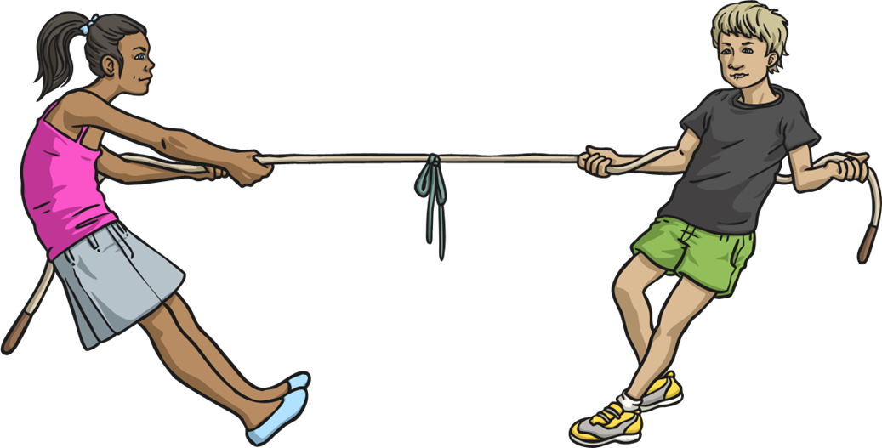
Being a Good Sport
Being a good sport means to be respectful. Everyone involved in a sport can show this - spectators can be good sports too.

Slide 8
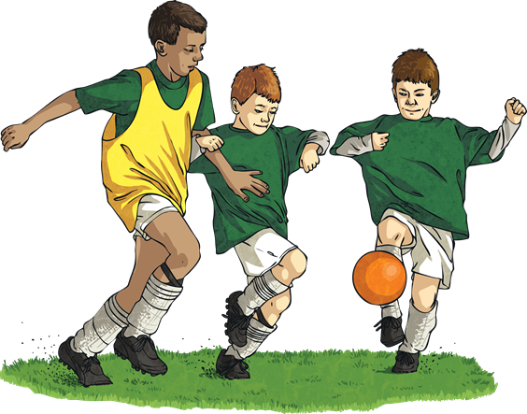
How Can We All Be ‘Good Sports’?
To be a ‘good sport’ you must:
always try your best;
say ‘well done’ to people who play well or win;
be gracious whether you win or lose;
use any disappointments as a motivation to win next time;
enjoy playing the game whether you are winning or losing;
play fair.

Slide 9
Inspiring Quotes from Sports Stars:
“Talent wins games, but teamwork and intelligence wins championships.”
Michael Jordan
(American basketball star)
"I always felt that my greatest asset was not my physical ability, it was my mental ability."
Caitlyn Jenner
(Olympic Decathlete)
“I never thought about losing, but now that it's happened, the only thing is to do it right.”
Muhammad Ali
(Boxing legend)

Slide 10
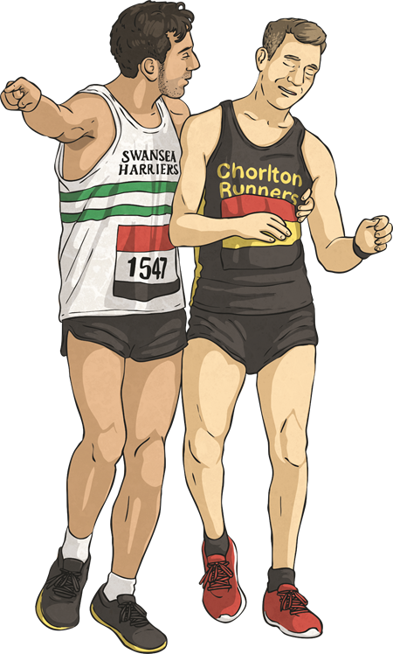
A Good Sport in Action
During the London Marathon, Matthew Rees from Swansea Harriers forgot about focusing on his own personal time to stop and help a complete stranger over the line.

Slide 11
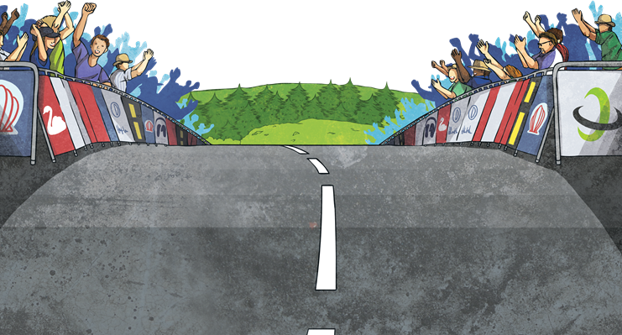
Time for Reflection…
Rudyard Kipling’s quote from the poem ‘If’ :
“If you can meet with Triumph and Disaster
And treat those two impostors just the same”
What does this mean?

